Slide 1
Evergreen International 2012
April 27, 2012
Keynote
Galadriel Chilton
University of Connecticut
galadriel.chilton@uconn.edu

Slide 2
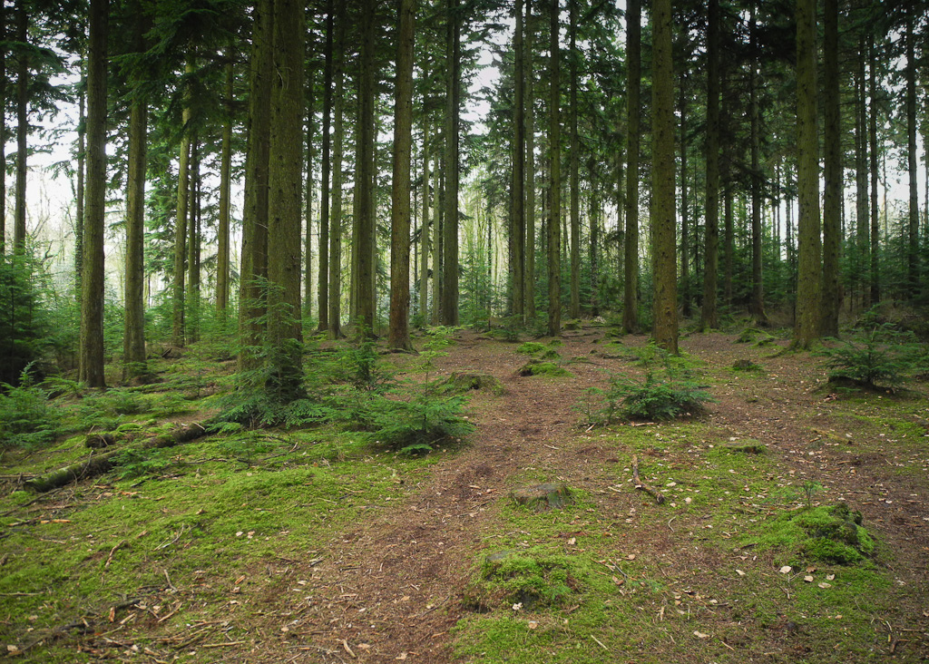
Photo by DartmoorGiant used in accordance with Creative Commons License.

Slide 3
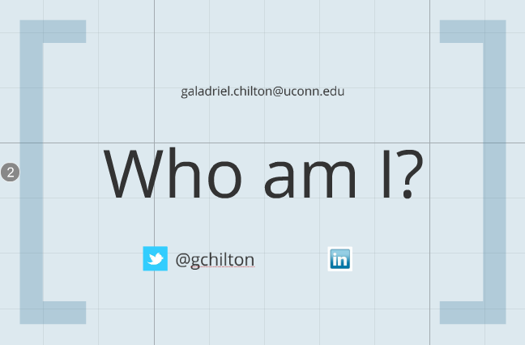

Slide 4
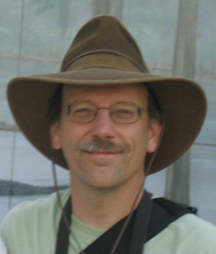
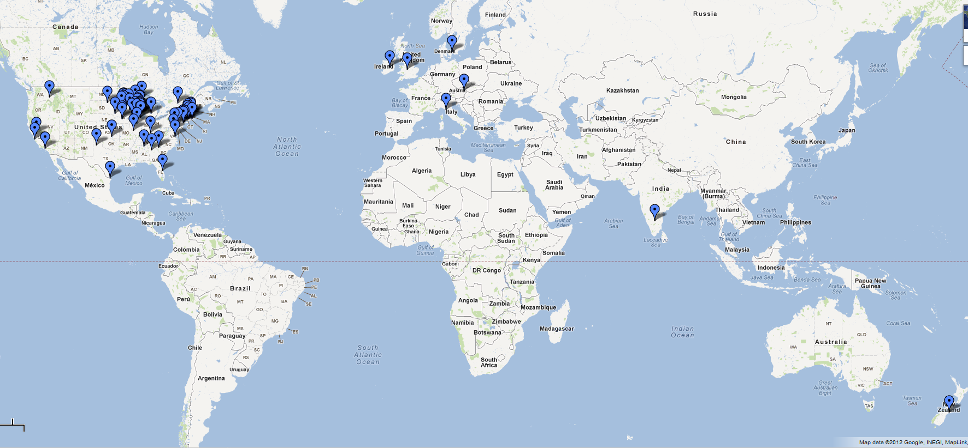
ERMes
An accidental open source e-resource management system.
William Doering
University of Wisconsin - La Crosse

Slide 6
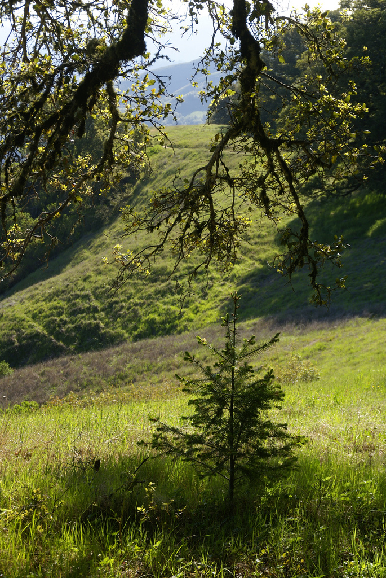
A sapling in the forest of evergreens.
Photo by DBaron used in accordance with Creative Commons License.

Slide 7
library, n.
Pronunciation: /ˈlaɪbrərɪ/
Forms: Also ME–16 librarie, ME lyberary , 15 liberary, librarye. β. ME librair(e, Sc. librar .
b. A building, room, or set of rooms, containing a collection of books for the use of the public or of some particular portion of it, or of the members of some society or the like; a public institution or establishment, charged with the care of a collection of books, and the duty of rendering the books accessible to those who require to use them.

Slide 8
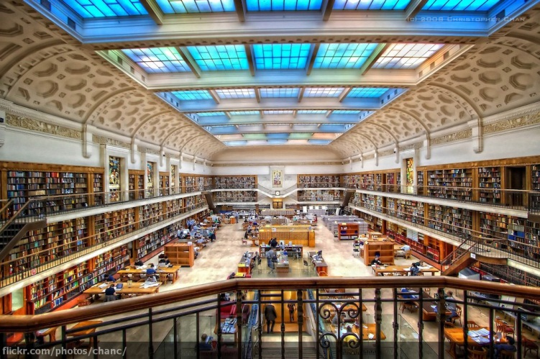
Photo by Christopher Chang used in accordance with Creative Commons License.

Slide 9
library, n.
Pronunciation: /ˈlaɪbrərɪ/
Forms: Also ME–16 librarie, ME lyberary , 15 liberary, librarye. β. ME librair(e, Sc. librar .
b. A building, room, or set of rooms, containing a collection of books for the use of the public or of some particular portion of it, or of the members of some society or the like; a public institution or establishment, charged with the care of a collection of books, and the duty of rendering the books accessible to those who require to use them.

Slide 10
li·brary
noun \ˈlī-ˌbrer-ē, -ˌbre-rē; British usually & US sometimes -brər-ē; US sometimes -brē, ÷-ˌber-ē, -ˌbe-rē\
4 : a collection of cloned DNA fragments that are maintained in a suitable cellular environment and that usually represent the genetic material of a particular organism or tissue.

Slide 11
[ Society ]

Slide 12
habitat, n.
Pronunciation: /ˈhæbɪtæt/
Natural Hist. The locality in which a plant or animal naturally grows or lives; habitation. Sometimes applied to the geographical area over which it extends, or the special locality to which it is confined; sometimes restricted to the particular station or spot in which a specimen is found; but chiefly used to indicate the kind of locality, as the sea-shore, rocky cliffs, chalk hills, or the like [such as a library].

Slide 13
librarian, n.
Pronunciation: /laɪˈbrɛərɪən/ 2. The keeper or custodian of a library.
(Oxford English Dictionary)
: a specialist in the care or management of a library
(Webster.com)

Slide 14
species, n.
Pronunciation: /ˈspiːʃiːz/ /ˈspiːʃɪiːz/
Forms: Pl. species ; also 16–18 specieses.
a. A class composed of individuals [librarians] having some common qualities or characteristics, freq. as a subdivision of a larger class or genus.
(Oxford English Dictionary)

Slide 15
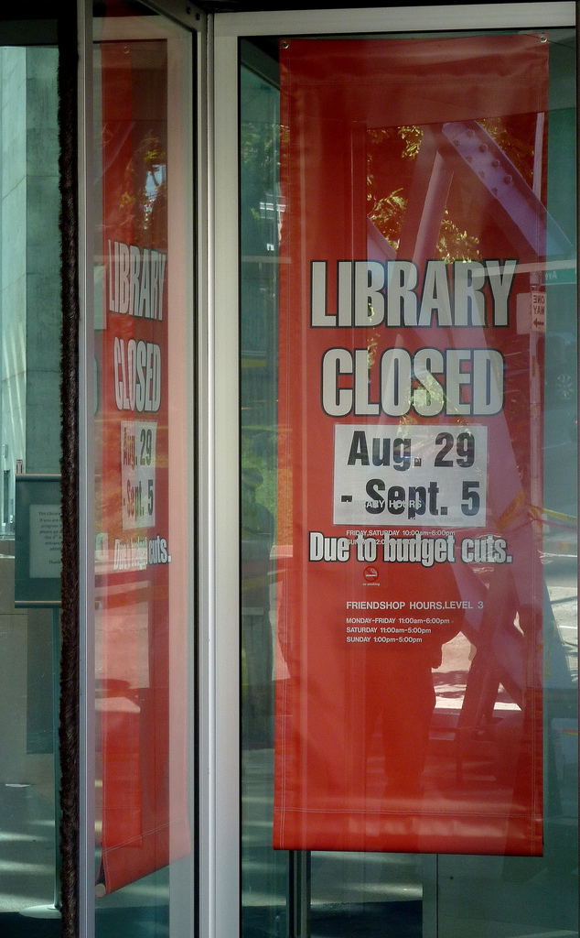
Photo by Phyllis Siegle, used with permission.

Slide 16
Image by Save Doncaster Libraries used in accordance with Creative Commons License.

Slide 17
Photo by Polly Alidiaused used in accordance with Creative Commons License.

Slide 18
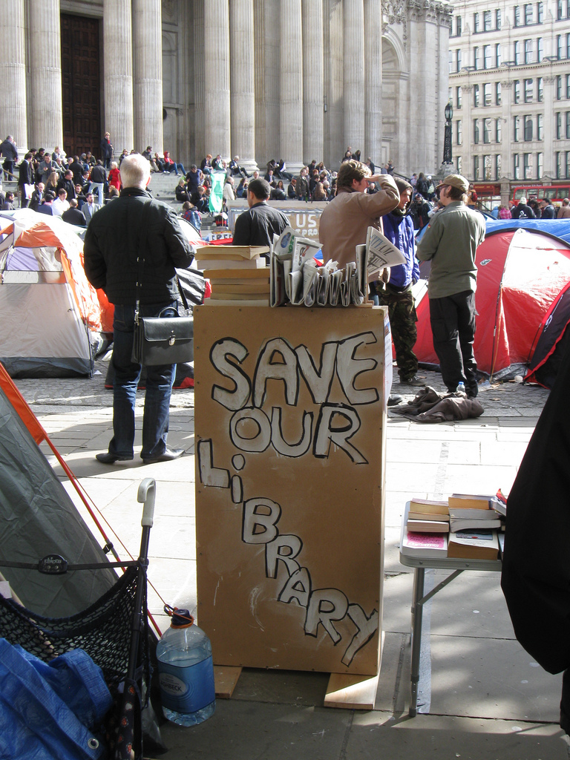
Photo by Nicksarebi used in accordance with Creative Commons License.

Slide 20
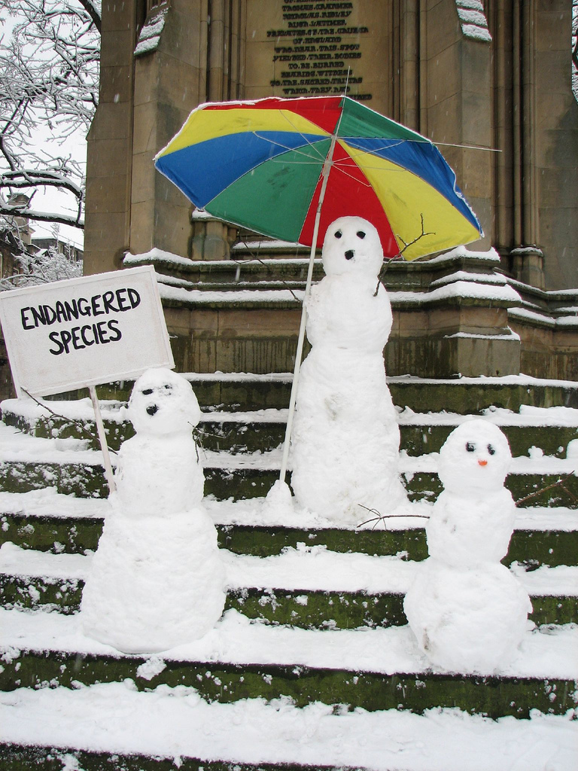
Photo by Lawrence OP used in accordance with Creative Commons License.

Slide 21
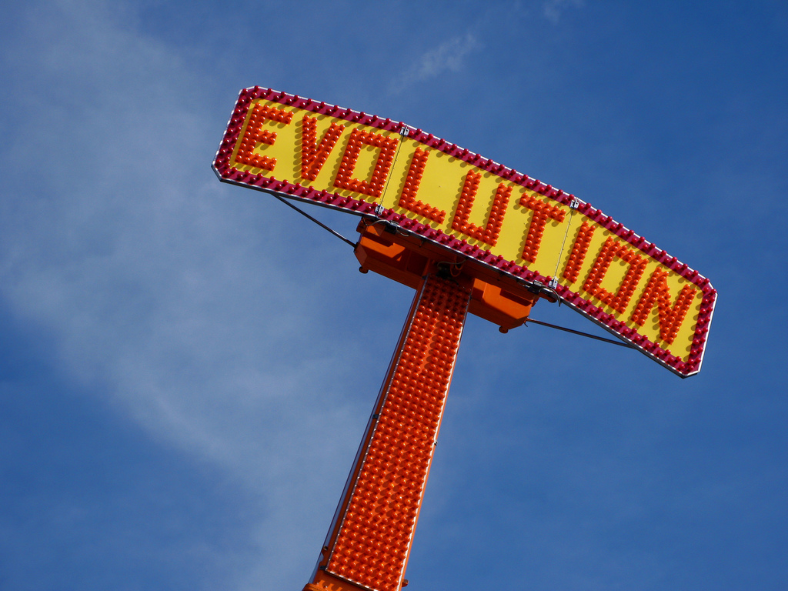
Photo by Kevin Dooley used in accordance with Creative Commons License.

Slide 22
Image of singular brute strength conquering all.

Slide 23
Photo by Tracy O used in accordance with Creative Commons License.

Slide 24
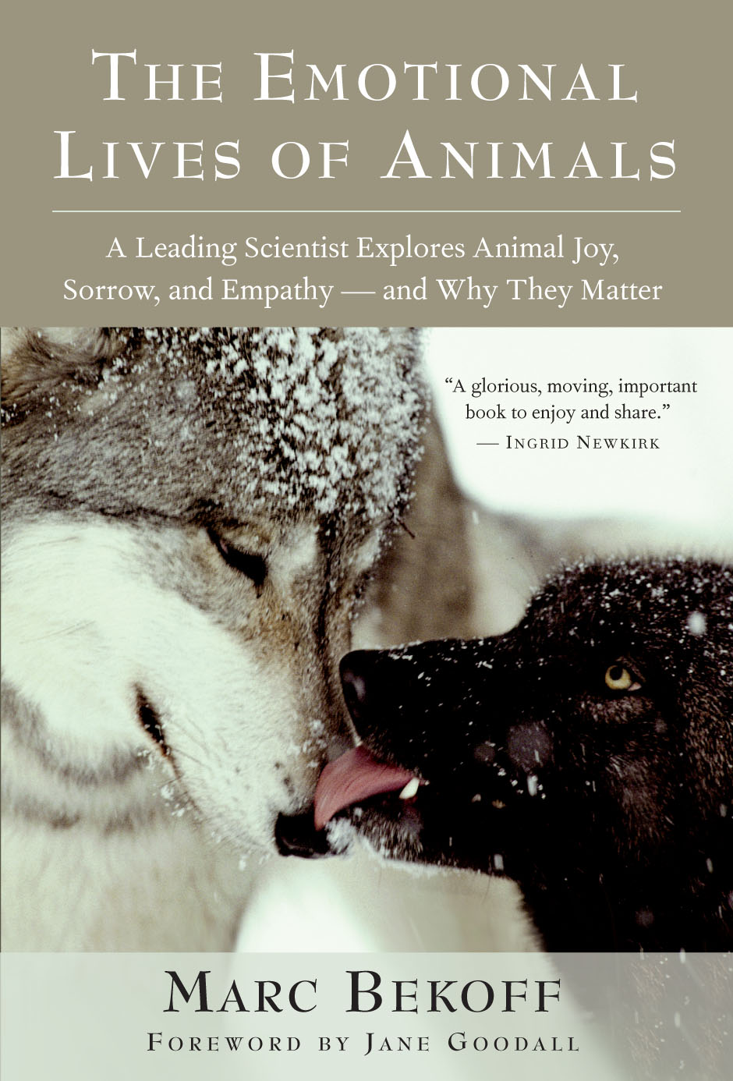

Slide 25
'"Survival of the fittest" has always been used to refer to the most successful competitor, but in fact cooperation my be of equal of more importance.“
- Marc Bekoff, Ethologist

Slide 26
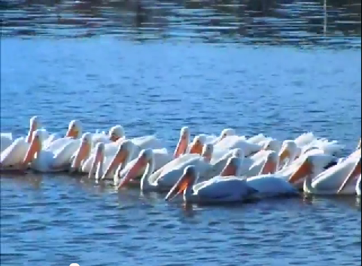

Slide 27
"Indeed, it almost seems trite to write about cooperation with one another and it's obvious why they do so: if the group works together, then each individual's chance for survival improves.“
- Marc Bekoff, Ethologist

Slide 28
"Cooperative interactions have to back competitive encounters so that the group will be cohesive and stable over time.“
- Marc Bekoff, Ethologist

Slide 29
"Animals certainly still compete, but cooperation is central in the evolution of social behavior, and this alone makes it key for survival.“
- Marc Bekoff, Ethologist

Slide 30
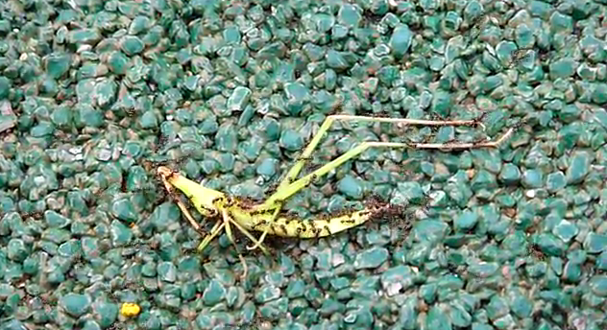

Slide 32
"I believe that at the most fundamental level our nature is compassionate, and that cooperation, not conflict, lies at the heart of the basic principles that govern our human existence...By living a way of life that expresses our basic goodness, we fulfill our humanity and give our actions dignity, worth, and meaning.”
- His Holiness the Dalai Lama, “Understanding Our Fundamental Nature”

Slide 33
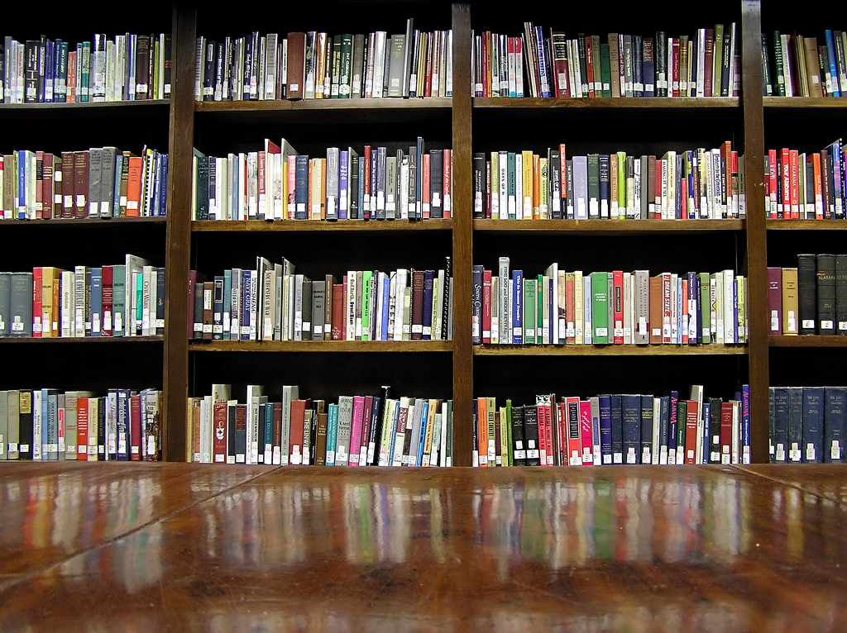
Photo by libraryman (Michael Porter) used in accordance with Creative Commons License.

Slide 34
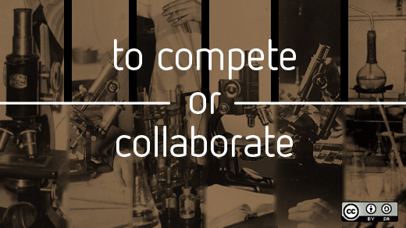
Photo by Open Source Way used in accordance with Creative Commons License.

Slide 35
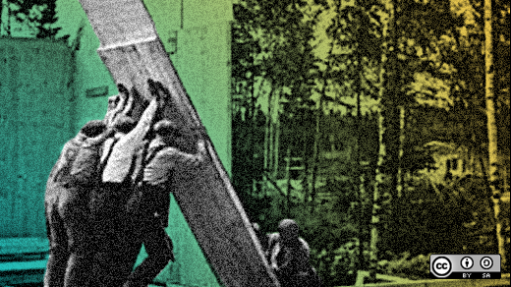
Photo by Open Source Way used in accordance with Creative Commons License.

Slide 36
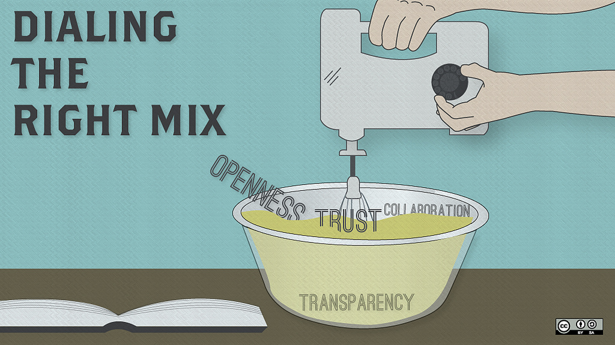
Image by Open Source Way used in accordance with Creative Commons License.

Slide 37
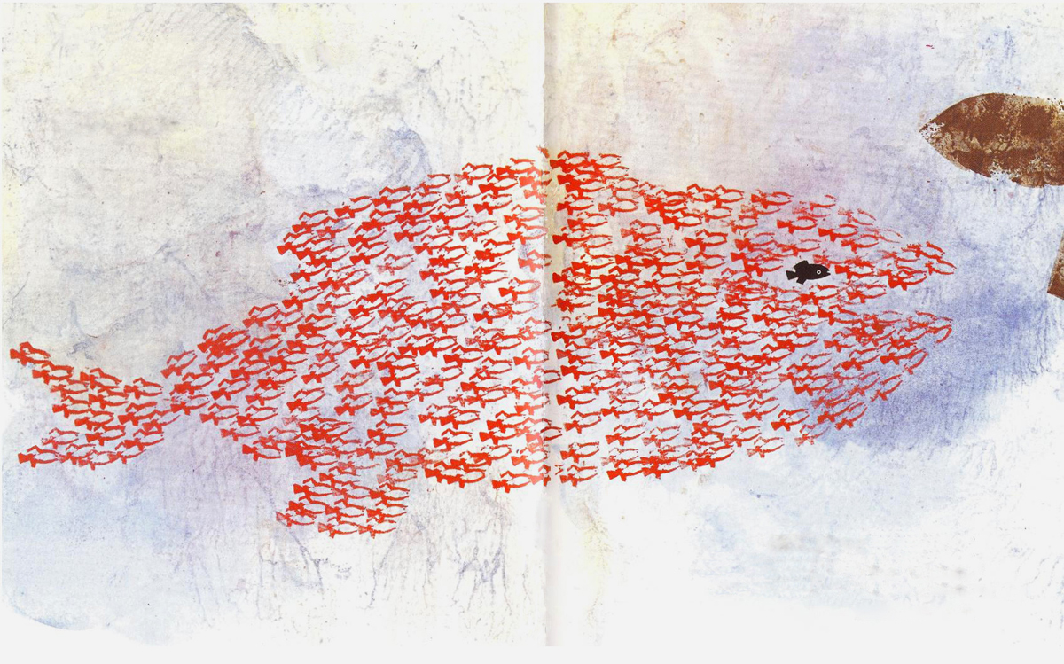
From Swimmy by Leo Lioni

