Slide 1
There & Back Again
A Journey in Handling Evergreen’s Network Needs

Slide 2
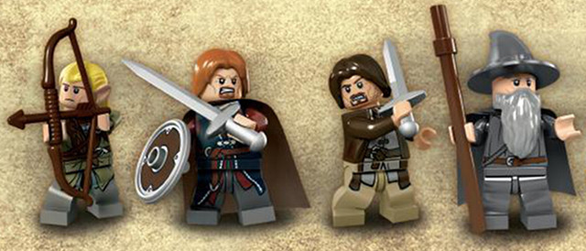
Four Adventurers
Galen Charlton, Equinox Software
Genevieve Francis, Bibliomation
Rogan Hamby, SC LENDS
Chris Sharp, GA PINES

Slide 3
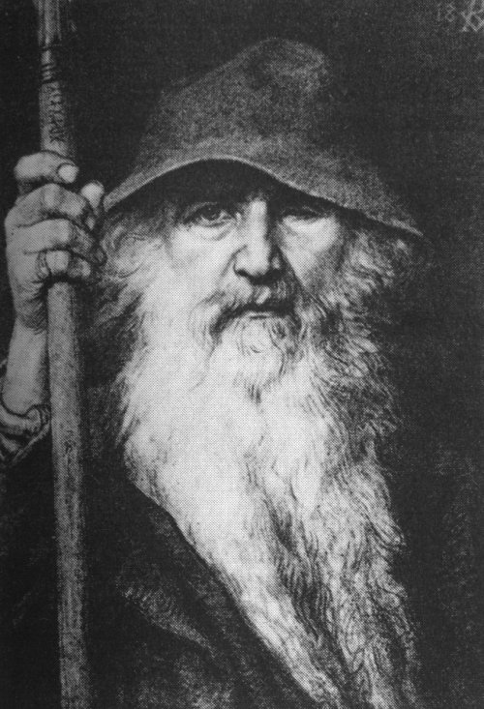
If “The Hobbit” were a networking parable the dwarves and Bilbo would have been packets.
Maybe Gandalf was the network admin. Long beard. Suspenders under his robe. Obviously a *NIX admin.

Slide 4
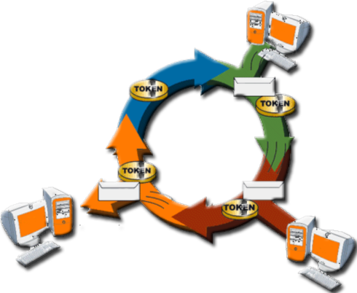
The One Token Ring

Slide 5
That Was A Networking Joke

Slide 6
OK, Enough Ice Breaking

Slide 7
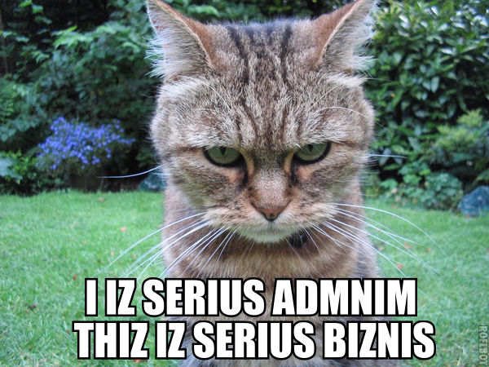

Slide 8
B A N D W I D T H

Slide 9
L A T E N C Y

Slide 10
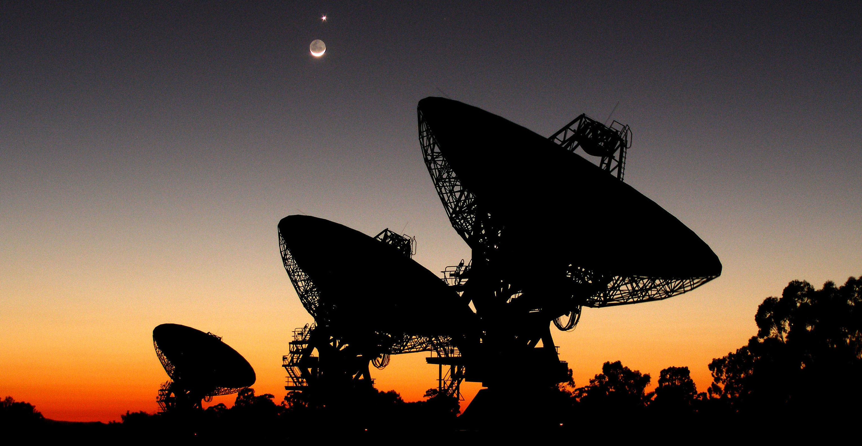
CONNECTIONS

Slide 11
X
CONNECTIONS

Slide 12
SECURITY

Slide 13
IN PLAIN TEXT

