Slide 1
Building the OPAC of your dreams: 2.X The final frontier
Lisa Hill King County Library System
www.kcls.org/evergreenopac2012

Slide 2
About KCLS
King County Washington(Everything but Seattle City proper)
46 libraries serve 1.3 million patrons
Circulated 22.4 items in 2010(busiest library of the year)
Catalog- 70.7 million page views in 2011
Web page- 40.3 million page views in 2011

Slide 3
Timeline- Major KCLS opac revisions
Go Live with Evergreen 09/24/2010
Dragon Slayers kill the grey screen 12/2010
New Skins for the OPAC
03/17/2011
Ecommerce 04/04/2011
PG 9.1 8/18/2011
2.1- Checkout history in order by newest first 09/26/2011
Template toolkit 10/24/2011

Slide 4
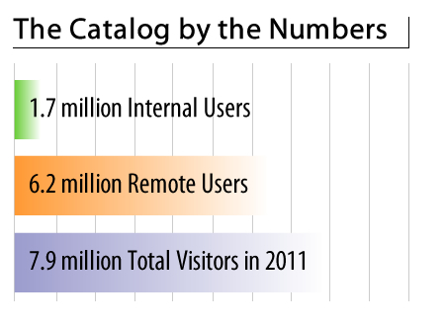
The catalog by the numbers…
88.8 million visits in 2011, with an average of 223,553 page views a day.
7.9 million visitors in 2011
6.2 million visitors are remote users, 80% of all visits to the catalog were from users not at our libraries.
21,000 visitors on an average day to the catalog
Notes:
While the numbers are not the same I am willing to bet your stats are the same☺

Slide 5
Usability & Patron Feedback
Our patrons have opinions and yours do too!
Identify what you have to have in your next release. With a migration be prepared that something will be missing….
Interview patrons
Identify a list of tasks for them and see if they can(easily) do it.
Notes:
Unique visitors sometimes when they clear their cache we will record that as a new user- but if they don’t it counts as the same visitor
Instead of this pie chart maybe use the internal vs external bar graph?

Slide 6
Usability take one…
OPAC Display Committee initiated Patron Usability
Wireframes of custom KCLS Evergreen OPAC
Twenty two patrons across King County participated in OPAC Usability
Our goal was to discover what works and what doesn't
Patrons were asked to complete fourteen tasks
Users asked to rate tasks: 1 -easy, 3-moderate, 5-difficult
No task had an average rating higher than 2.39
All tasks had an average rating of 1.3
Notes:
Wireframes are mockups of how we are thinking of having a page laid out before we pay to have them coded.
Patrons were recruited from an online survey that in 48 hours over a time span of 4 days received 5000 responses
The three tasks that were rated the most difficult were Limit to Available, Suspend a Hold, and Find the newest Sports Book. The three tasks that were rated the easiest were Login to your Account, Place a Hold on an Item, and Return to the List of Search Results. Over 90% of the participants were satisfied with how easy it is to use the new KCLS online catalog and they felt that the online catalog has all the functions and capabilities they expect it to have. 100% of the participants were confident they could complete their library-related tasks using the new KCLS online catalog and that it was easy for them to find the information they needed in my library account. Overall our patrons found the OPAC and its Account features easy to use.
Tasks
Task 1 - Reflect on Catalog - (Average rating 1.32)
Task 2 - Login to your Account - (Average rating 1.05)
Task 3 - Search for Sports - (Average rating 1.33) Task 4 - Limit to Available Items - (Average rating 2.05)
Task 5 - View the details of an Item - (Average rating 1.36)
Task 6 - Place a hold on an item - (Average rating 1.09)
Task 7 - Return to the List of Search Results - (Average rating 1)
Task 8 - Limit Search Results by Format - (Average rating 1.36)
Task 9 - Check Holds List - (Average rating 1.23)
Task 10 - Suspend a Hold - (Average rating 2.32)
Task 11 - Cancel a Hold - (Average rating 1.41)
Task 12 - Reflect on Account page - (Average rating 1.24)
Task 13 - Renew an Item - (Average rating 1.5)
Task 14 - Find the newest Sports book - (Average rating 2.39)

Slide 7
Usability One Results…
What we did with usability results
Fixed Screen Placement issues
Reduced clutter
Increased white space
Identified and reduced library jargon
Notes:
We learned a great deal from this study. Thirty two questions were generated that were answered about the OPAC before the modified wireframes were sent on to the developers to code. We are hoping to complete another set of usability once we receive the actual OPAC.

Slide 8
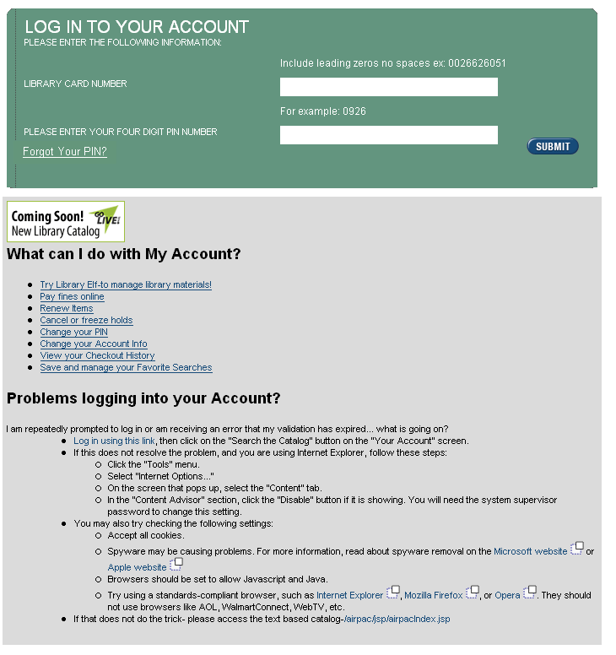
Usability One Results…
Notes:
This is what our old screen looked like under III- and this is what the new screen looks like.

Slide 9
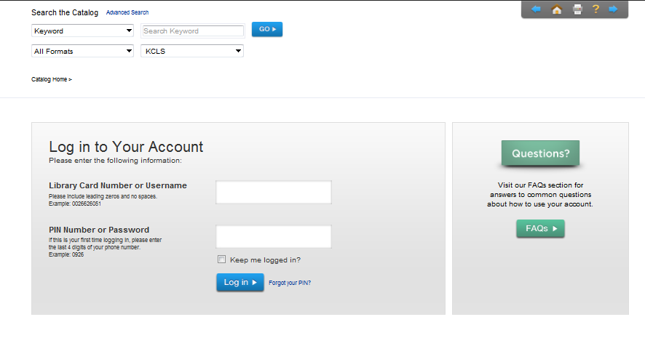
Usability One Results…
Notes:
We learned a great deal from this study. Thirty two questions were generated that were answered about the OPAC before the modified wireframes were sent on to the developers to code. Another round of usability will be scheduled later this year.

Slide 10
Evergreen 2.x
Speed is improved(template toolkit)
Patrons will be able to manage library accounts quickly and easily… and log in.
Staff will be able to execute advanced searches quickly.
Browser Agnostic(Users should not be forced to use a certain browser ala 1998)
My Account features

Slide 11
“IF everything seems under control, you're not going fast enough.”
30 seconds to One minute for folks to log in
Patrons on Satelite, DSL and AOL could not log in
About 11,000 complaints 85% of them were about speed
KCLS tried to combine the JS Calls in an effort to speed up the OPAC- but in the end ESI felt that the next step should be… template toolkit(TPAC)
Notes:
A snappy user experience beats a glamorous one- Jakob Nielsen says it best
.1 seconds gives the feeling of instantaneous response
1 second- the users flow is seamless
10 seconds keeps the users attention
Anything over 10 seconds and users will start leaving a site- because now the are conciously aware that the are waiting on the computer

Slide 12
Slow, Slower, Slowest
We asked patrons if they felt template toolkit was faster and 65% said yes.
Catalog usage has increased by 20% since we launched T-PAC
Use of our mobile catalog has dropped off by about 15%
DSL, Satellite, and AOL users were able to log in
Notes:
While they mentioned missing features in the survey- the overall satisfaction with the catalog was higher for the TPAC than the JSP

Slide 13
My Account Features
Update Account information
My Lists (Book Bags) improved UI
Checkout history
Holds History
Ecommerce
Notes:
Unique visitors sometimes when they clear their cache we will record that as a new user- but if they don’t it counts as the same visitor
Instead of this pie chart maybe use the internal vs external bar graph?

Slide 14
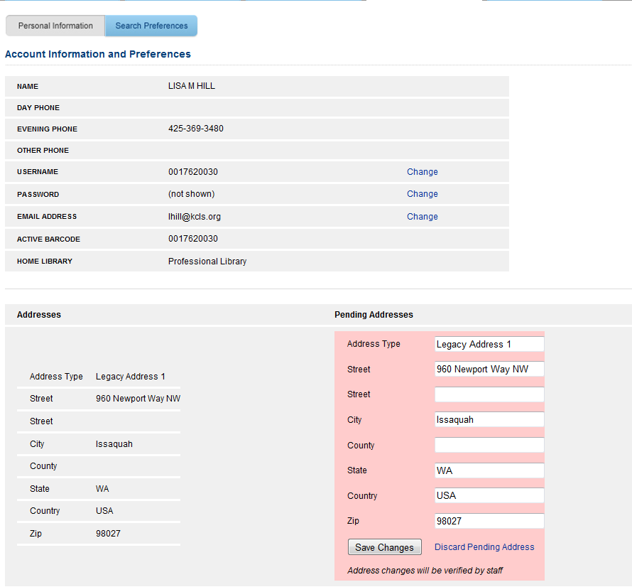
Pending Address

Slide 15
My lists(aka book bags)
KCLS started offering this in 2009
My Lists by the numbers
16,801 users
29,407 lists
2,171 shared
Ability to title and easily place holds from your list is new with 2.2

Slide 16
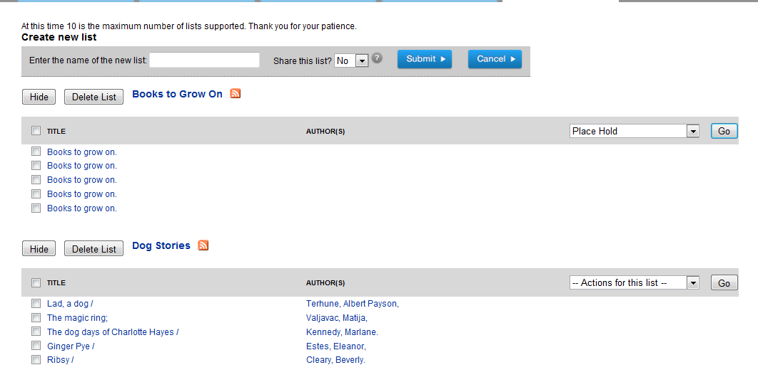
My lists(AKA Book Bags)
Notes:
A few tweaks still needed
Ability to add more than 10 lists
245 abnp need to show(KCLS should have that rectified in a few weeks)
Inability to move items between lists

Slide 17
Checkout history
KCLS started offering this in 2004
We have 244,108 patrons using this feature
2.1 displays newest first
Notes:
This was one of the biggest complaints when we brought checkout history back- I was just relieved it migrated from III to Evergreen

Slide 18
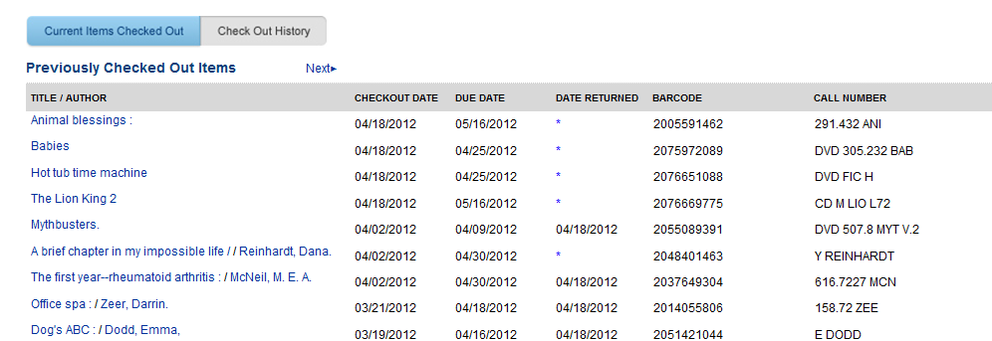
Checkout history
Notes:
Date Returned/Date Renewed

Slide 19
Holds history
Holds History
We had this with Dynix- it was a yearly list
We plan on making it yearly with Evergreen
1,575 users- we have not promoted this- keeps track of expired holds, and completed holds
Notes:
Currently it does not keep track of user cancelled holds

Slide 20
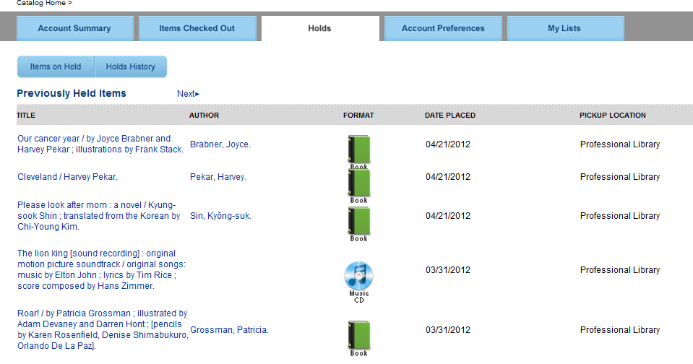
Holds history

Slide 21
Ecommerce
KCLS Launched ecommerce in 2005
Visa and MasterCard
$40,000 a month
Average transaction $8.00
Working on obtaining PCI compliance
Notes:
Better screens in 2.1 and go with the TPAC instance of it due to the double charges
We have a stop at 10.00

Slide 22
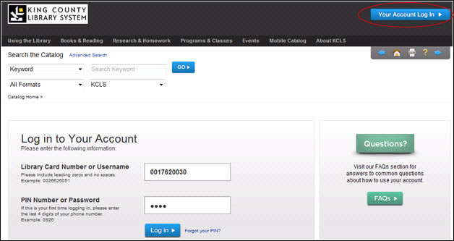
Show me the money
Notes:
FYI- Our old My account screen had WAY to much information- something that non of our patrons needed anyway so we simplified the screen and updated the input fields to be bigger to match the other trends

Slide 23
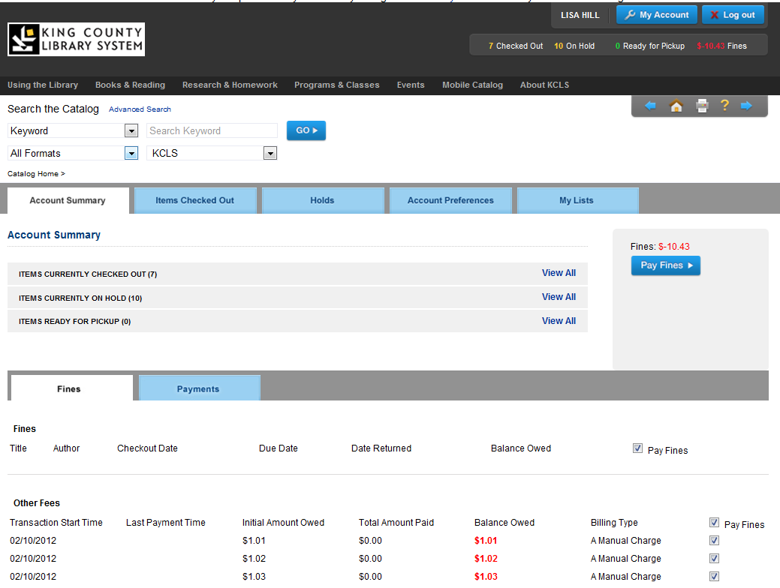
Show me the money
Notes:
Originally, we had asked that they pay fines be deselected so that patrons would have to choose the fines they want to pay- but you know- Patrons don’t read- so after countless errors we select all of the fines for them automatically…

Slide 24
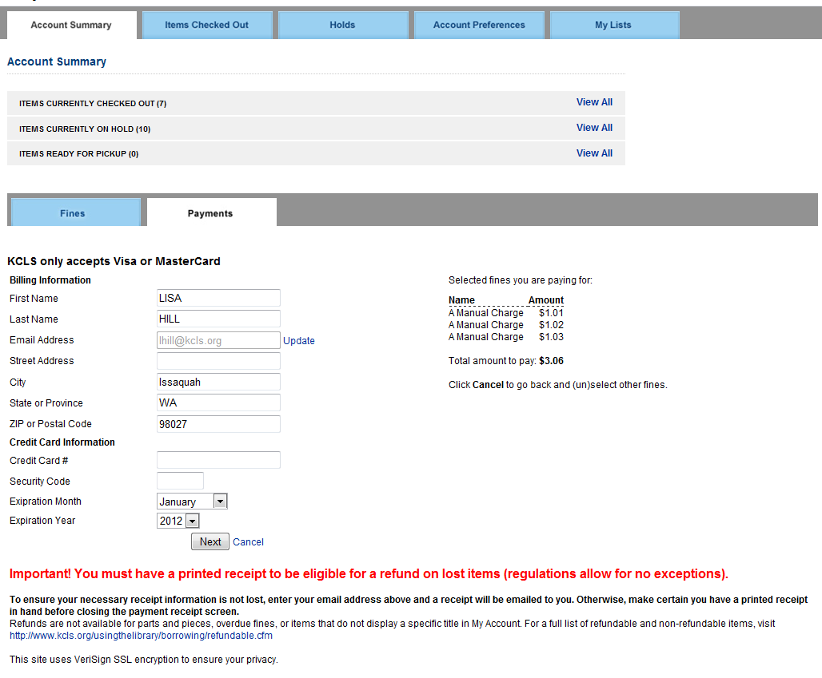
Show me the money
Notes:
The name and email address, city and state autopopulate-
Gauge the crowd if you want to mention something about the fraud filter

Slide 25
Show me the money
Notes:
The name and email address, city and state- this MUST match the Credit card information and not the library card

Slide 26
Show me the money
Notes:
The best thing about this module is the ability to print or email your receipt on demand.
Since we offer a 1 year refund policy it is so great to offer this service.

Slide 27
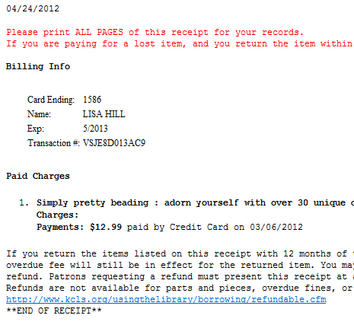
Show me the money
Notes:
Since we offer refunds- we have to have the transaction number to refund the patrons- so make sure when you implement this you have the transaction number appear on the receipt.

Slide 28
What’s next
Bringing our skins to mirror the community 2.2 build
Search improvements
Browse Searching, Left Anchor searching
Faceting
My Lists improvements
Notes:
Unique visitors sometimes when they clear their cache we will record that as a new user- but if they don’t it counts as the same visitor
Instead of this pie chart maybe use the internal vs external bar graph?

Slide 29
Questions?

